Slide 1

SMART INDIA HACKATHON 2026
DepositFlow:
Intelligent Security Deposit & FDR Management Portal
Problem Statement ID – SIH26265
Problem Statement Title – Streamline of Security Deposit / FDR Portal
Theme – Smart Automation
PS Category – Software
Team ID – 155882
Team Name – SPADES

Slide 2
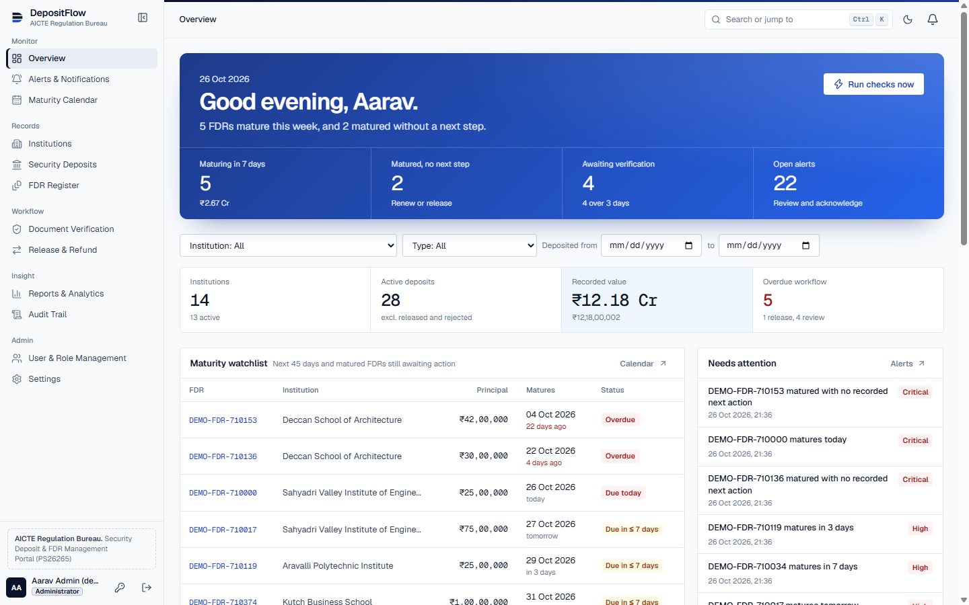
PROBLEM STATEMENT &
PROPOSED SOLUTION
SPADES
PROBLEM Security deposits and FDRs are tracked in spreadsheets and email, so maturity dates are missed and no one can prove who verified or released what.
OUR IDEA One secure register that tracks every deposit from receipt to release, with automatic maturity alerts and a tamper-proof audit trail.
1
CHALLENGES
PROPOSED SOLUTIONS
Scattered spreadsheet records
Central register of institutions, deposits and FDRs
Missed maturity dates
Rule engine with alerts at 30, 15, 7 and 0 days
2
3
Uploaded but unchecked receipts
Verification queue: approve, reject or return with remarks
Amount or date mismatches
Automatic register-versus-document discrepancy check
Renewals overwrite history
Renewal creates a new linked FDR; old record kept
1
Today band
Unclear release approvals
Request, approve and record as separate audited steps
What matures this week, at a glance
Edited or deleted records
Append-only audit trail enforced by the database
2
Maturity watchlist
Next 45 days plus overdue FDRs
Wrong people seeing data
Five roles; institutions see only their own records
3
Needs attention
No overview for officers
Live dashboard, calendar and seven exportable reports
Critical alerts ranked first
KEY INNOVATION
Computed maturity status (not typed)
Duplicate-proof scheduled alerts
Discrepancy detection
Append-only audit trail

Slide 3
TECHNICAL APPROACH
SPADES
SYSTEM WORKFLOW
Institution input
Verification & rules
Officer & audit
01 Institution signs in
02 Deposit + FDR registered
03 Receipt uploaded
04 File type checked from bytes
05 Stored privately
06 Verification queue
07 Officer decision
08 Discrepancy check
09 Maturity computed daily
10 Scheduled alert rules
11 Notifications & escalation
12 Release request & approval
13 Outcome recorded
14 Audit trail & reports
TECH STACK
SECURITY BY DESIGN
FIVE ROLES
Next.js 16 + React 19 (TypeScript)
PostgreSQL (Neon free tier) / PGlite locally
Tailwind CSS design system
Recharts dashboards
Zod validation on client and server
Vitest + Playwright testing
scrypt password hashing
Server-side sessions, 12 h / 2 h idle
Lockout after 5 failed sign-ins
Role checks on every server action
Signed, expiring file links
CSP, HSTS and security headers
Administrator
Institution User
Verification Officer
Finance Officer
Auditor
3-LAYER
APPROACH
1
Secure Records
2
Rule Automation
3
Dashboards & Audit
GitHub: github.com/LORDXMANOJ/deposit-flow
Live: deposit-flow-inky.vercel.app
Progress: working prototype, 89 automated tests passing
Demo Video

Slide 4
FEASIBILITY AND VIABILITY
SPADES
TECHNICAL FEASIBILITY
CHALLENGE VS SOLUTION
TARGET OUTCOMES
Built on free, open-source tools
Challenge
Engineering Solution
AUTOMATED TESTS
Many users at once
Stateless servers sharing one Postgres
89 / 89 passing
Runs on free-tier hosting (Vercel + Neon)
Duplicate alerts
Unique key per rule, record and threshold
Record tampering
Database trigger blocks audit edits
Backend, security & workflow
Same PostgreSQL schema locally and hosted
Unauthorised access
Server-side role and institution checks
Verification turnaround tracked
Working prototype, not a mock-up
VALIDATION & EVALUATION PLAN
Renewal reminder coverage
Scales by adding stateless servers
Boundary-date tests (today, +1, +7, +8, +31 days)
Authorisation attack tests
Discrepancies caught
Feasibility criteria met 5 / 5
Duplicate-alert tests
End-to-end browser walkthrough
Full audit history
Postgres driver tested over the wire protocol
COMMERCIAL
FEASIBILITY
HOSTING COST
TARGET USERS
SCALING PATH
TIMELINE
₹0 on free tiers for the pilot; paid tiers (est.) only at national scale
AICTE Regulation Bureau, approved institutions, bank liaison officers
Add institutions without code changes; move to a managed Postgres plan
Prototype: done · Pilot with one region: 3–6 months (est.)

Slide 5
IMPACT AND BENEFITS
SPADES
DIRECT IMPACT ON TARGET USERS
AICTE Regulation Bureau
Approved Institutions
Verification Officers
Finance & Accounts
Auditors & Vigilance
One view of every deposit
Overdue items surface automatically
Submit and track online
Know exactly what is pending
Register beside the document
Mismatches flagged before approval
Clear approval trail
No release without approval
Tamper-proof history
Exportable reports
SCATTERED DEPOSIT RECORDS
DepositFlow Register
ACCOUNTABLE, ON-TIME DECISIONS
STRATEGIC IMPACT & ECONOMIC BENEFITS
Sustainable Development
Administrative Benefits
Economic Benefits
SDG
16
Peace, Justice & Strong Institutions
(16.6: accountable, transparent institutions)
No missed maturities
Faster verification
One source of truth
Less follow-up by email
Runs on free-tier hosting
Open-source stack
Fewer lapsed deposits
Less manual effort
SDG
9
Industry, Innovation & Infrastructure
Security & Compliance
Strategic Benefits
SUPPORTS
Digital India
Paperless Governance
Role-based access
Append-only audit trail
Hashed passwords
Private document storage
Transparent regulation
Data for policy decisions
Ready to extend nationally
Builds trust with institutions

Slide 6
RESEARCH AND ANALYSIS
SPADES
LITERATURE SURVEY (RESEARCH-DRIVEN DESIGN)
PROTOTYPE & TEST RESULTS
1. SIH26265 Official Problem Statement
Expected outcomes: central repository, verification, maturity alerts, release workflow, audit.
Source: SIH 2026 portal (sih.gov.in/sih2026PS)
2. General Financial Rules 2017
Bid security and performance security rules for government deposits.
Source: Department of Expenditure, Ministry of Finance
CURRENT STATUS
Portal: live, working prototype
Login & roles: implemented
Alerts: scheduled and on demand
Tests: 89 passing
Bank verification API: awaiting access
Email / SMS: planned
Benchmark: works within free-tier limits
3. NIST SP 800-63B Digital Identity
Length-based password policy, lockout and session limits.
Source: NIST
4. OWASP Top 10 & ASVS
Access control, authentication and injection defences.
Source: OWASP Foundation
Maturity Calendar
Document Verification
Release Workflow
Alert Engine
Audit Trail
CSV Reports
GAP & PROBLEM IDENTIFICATION
Manual, email-based tracking of deposits.
Source: SIH26265 problem statement
EXISTING APPROACH
Spreadsheets and paper files vs a single audited register.
5. Digital Personal Data Protection Act 2023
Minimal personal data and protected storage.
Source: Ministry of Electronics & IT
6. WCAG 2.2 Accessibility
Contrast, keyboard use and reduced motion for officers.
Source: W3C
SECURITY BENCHMARK
Controls mapped to OWASP Top 10.
Source: OWASP
POLICY ALIGNMENT
Digital India, paperless governance.
Source: MeitY
Developed Portal: DepositFlow · Live: https://deposit-flow-inky.vercel.app

